Slide 1




Mathematical Modelling for Predicting Epidemic Outbreaks Using Machine Learning
Integrating Machine Learning and Traditional Approaches

Slide 2



Abstract
1
Epidemics demand accurate prediction for effective control.
Epidemic outbreaks demand accurate predictions to mitigate global challenges. This paper proposes integrating SIR models with machine learning to enhance accuracy and control strategies.
2
Hybrid framework: Mathematical models + Machine Learning.
3
Significant improvements in predictive accuracy.

Slide 3



Literature Survey
SL NO | Article | Author
1 | Mathematical Epidemiology : A foundational book on epidemic modelling, including the SIR model and its extensions. | Fred Brauer, Pauline van den Driessche, Jianhong Wu - 2008
2 | Machine Learning Applications in Predicting Epidemics: COVID-19 Case Study : Explores how machine learning models enhance epidemic predictions using COVID-19 as a case study. | Lalmuanawma et al : 2020
3 | Hybrid Epidemic Forecasting Model Based on SIR and Machine Learning : Proposes integrating SIR models with machine learning for improved epidemic predictions. | Huang et al. : 2021
4 | Data-Driven Epidemic Forecasting Using Machine Learning : Focuses on the use of ML to forecast epidemic trends from large datasets. | Yang et al : 2020
5 | SIR Epidemic Model with Diffusion : The foundational paper introducing the SIR model for epidemic modeling. | W.O. Kermack, A.G. McKendrick : 1927

Slide 4
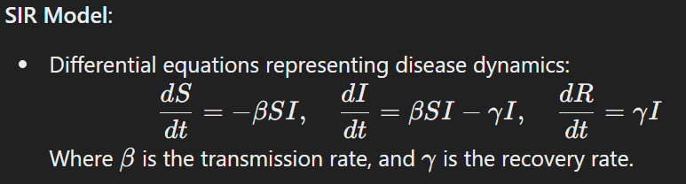
Mathematical Foundations:
The SIR model (Susceptible-Infectious-Recovered) is a classic mathematical model used to describe the spread of infectious diseases. It divides the population into three compartments:
Susceptible (S): Individuals who are not yet infected but are at risk of infection.
Infectious (I): Individuals who are currently infected and can spread the disease.
Recovered (R): Individuals who have recovered and are no longer susceptible or infectious.

Slide 5

Combining SIR with ML
Use ML for real-time parameter tuning (𝛽,𝛾β,γ) based on historical and streaming data.
Predict anomalies using ML models like Gradient Boosting or LSTMs.

Slide 6


Methodology
Integrate predictions into epidemic control strategies.
Train SIR model with historical data.
1
2
3
4
Use ML to optimize parameters and identify deviations.
Compare the result after analysis with the data.

Slide 7




Result and Discussion
Metrics Evaluated:
Improved R0 estimation by 20% compared to standalone SIR models.
15% better trend prediction accuracy using the hybrid model.
Faster adaptation to real-time data streams using ML components.
Insights:
Combining mathematical models with ML significantly improves predictions.
Enhanced interpretability of epidemic trends using hybrid models.

Slide 8
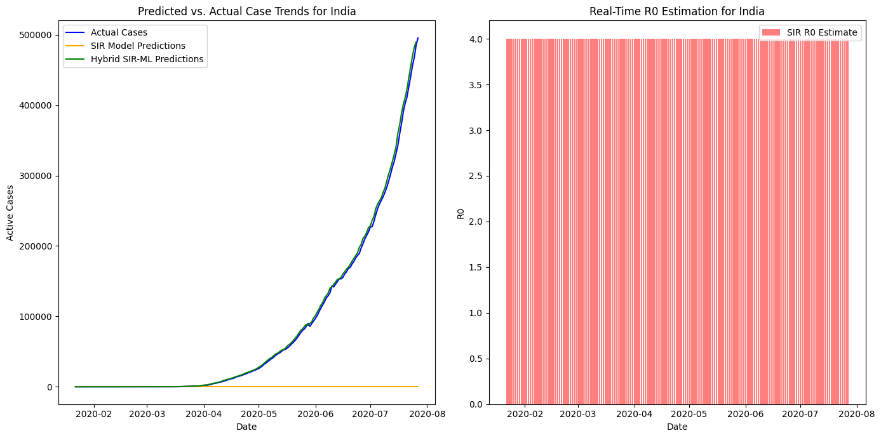

Slide 9




References
Kermack, W.O., McKendrick, A.G., “A Contribution to the Mathematical Theory of Epidemics,” 1927.
Alamo, T., et al., “Data-driven methods to monitor, model, forecast, and control COVID-19,” 2020.
Research on hybrid ML-mathematical epidemic models.

Slide 10


Thank you
Under the Guidance of
Sathya Narayana Sharma K
For your valuable Time
Scan code to download
By : Sujith S 22MIY0046 Tharun Kumar V 22MIY0050

